Slide 1

Predicting TOP rated upcoming games
Project by: Andrea ternera
Capstone #2

Slide 2



Gaming industry
In 2021 the US spent $60.4bn USD in the gaming industry (accessories, content, hardware).
North America in 2022 was the second highest region spending $49.7bn (~27% of the total global market).
Forecasted to reach $206.4 bn globally in 2025
What are we aiming for?
Develop a model that can potentially predict a game’s rating based on recorded game features.

Slide 3
Obtaining the data
IGDB (Internet Game Database) is an online database about video games.
Around 99,000 members, 428,000 games, and over 1.1 million video game reviews.
Content is user focused, letting registered users' rate, list and review games.
The first beta version contained around 200 fame titles and was launched in 2014.
In 2015 they launched their developer API
Free for non-commercial
Twitch account – register application – generate secret – take note of Client ID and Client Secret
Use POST request with specific endpoints to obtain dataset

Slide 4
Data set
IGDB developer API endpoints used:
Game: We obtained a dataset with 5807 games and 58 columns of game features.
Category, game modes, player perspective, genres, name, id, rating, total rating, platforms, language, etc.
Platform: Used to translate the information provided in the game request for platform.
200 platforms pre-divided in 6 categories used for analysis
Genres: Used to also translate the ids provided in the game request for genres
23 different genres including shooter, puzzle, racing, simulator, adventure, and more.
CONSOLE | ARCADE | PLATFORM | OPERATING SYSTEM | PORTABLE CONSOLE | COMPUTER
Sega, PS2, Meta Quest, etc. | Hyper Neo Geo 64 and MVS, Arcade, etc. | Amazon Fire TV, Google Stadia, AirConsole, etc. | iOS, PC, Mac, Linux, etc. | Nintendo Dsi/3DS/DS, Game Boy, PSP, etc. | Atari 8-bit, Amiga, Apple II, HP 2100/3000, etc.

Slide 5
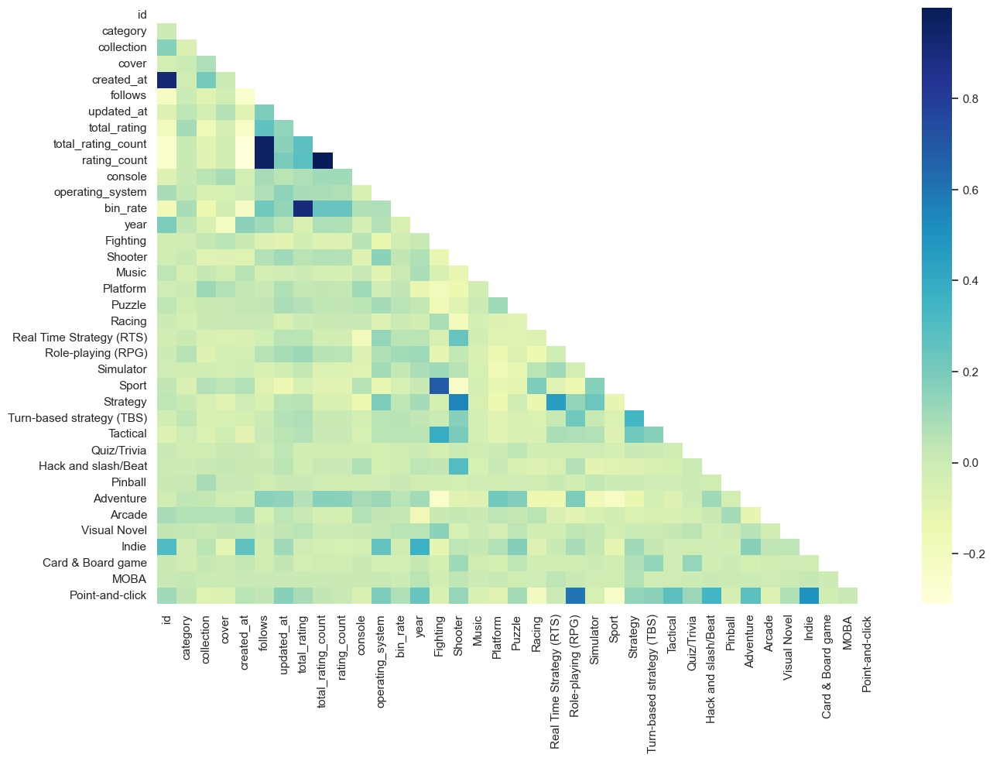
Exploratory data analysis
16 games have duplicate names.
2337 games have a rating higher than 50
26 columns had over 60% missing values.
Target variable: Total rating.
Cleaned data set contained
4265 rows
29 columns.

Slide 6
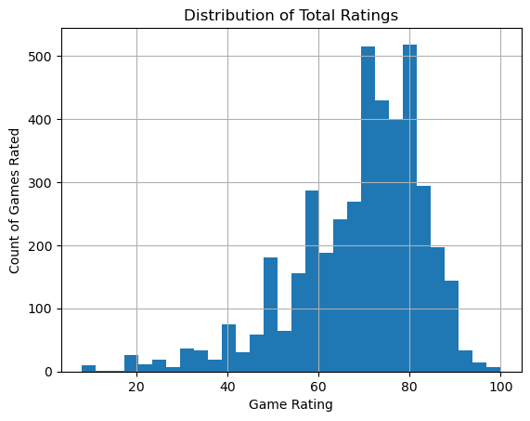
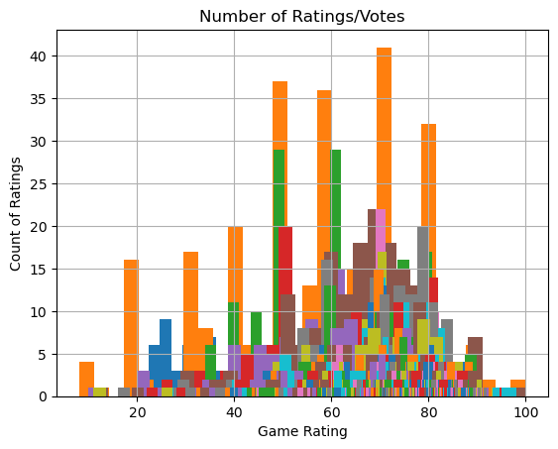
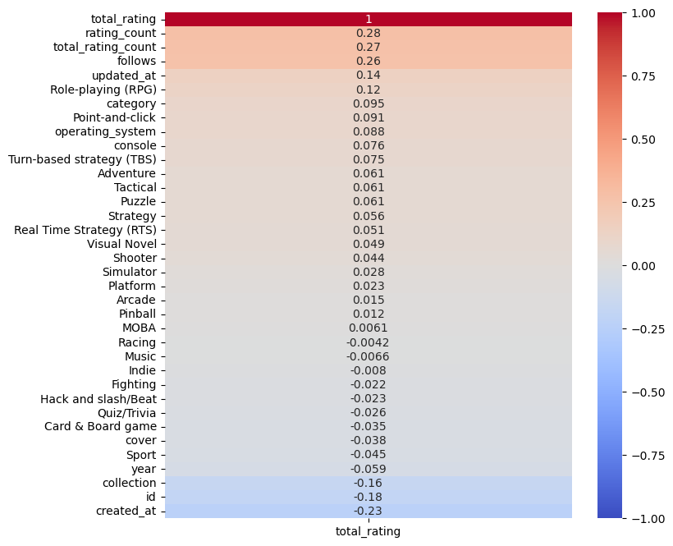
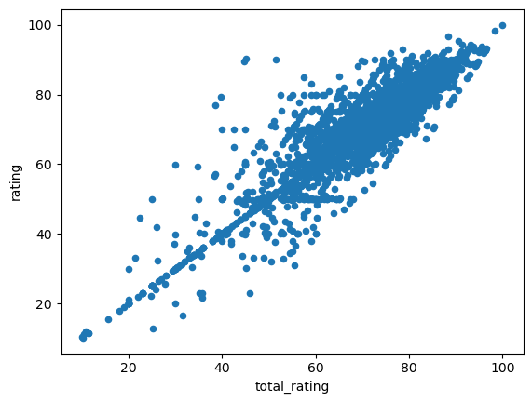
Target feature
Total rating (Average rating based on both IGDB user and external critic scores)
Rating and total rating follow a similar slope.
Over 500 games rated 70 or 80
Most games are rated between 59-85
Very few games have more than 30 votes/rates by users.
A significant number of games have between 5 and 22 votes/rates.
Highest correlation:
Rating_count
Total_rating_count
Follows
Updated_at
Role-playing (RPG) *genre*
Notes:
Rating ( only had igdb user rating) had missing ratings for some games while total rating did not

Slide 7
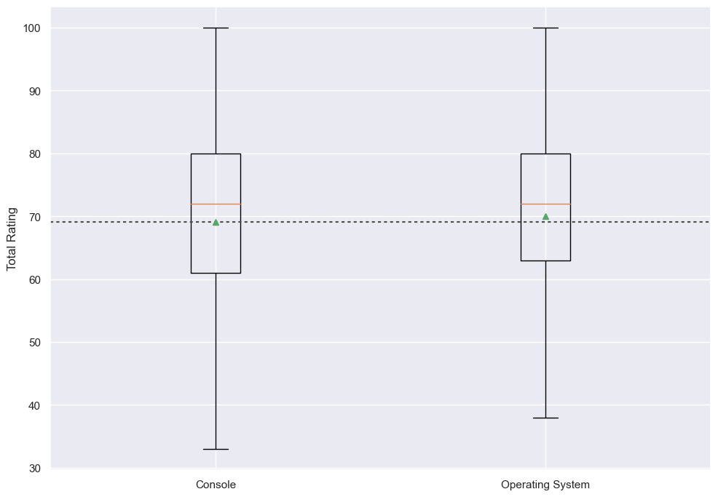
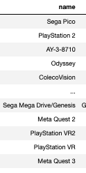
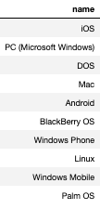
Console & rating
Two consoles represented in our dataset:
console
operating system.
Similar spread for both
Operating system has a slighter higher average than console by about 3 points.

Slide 8
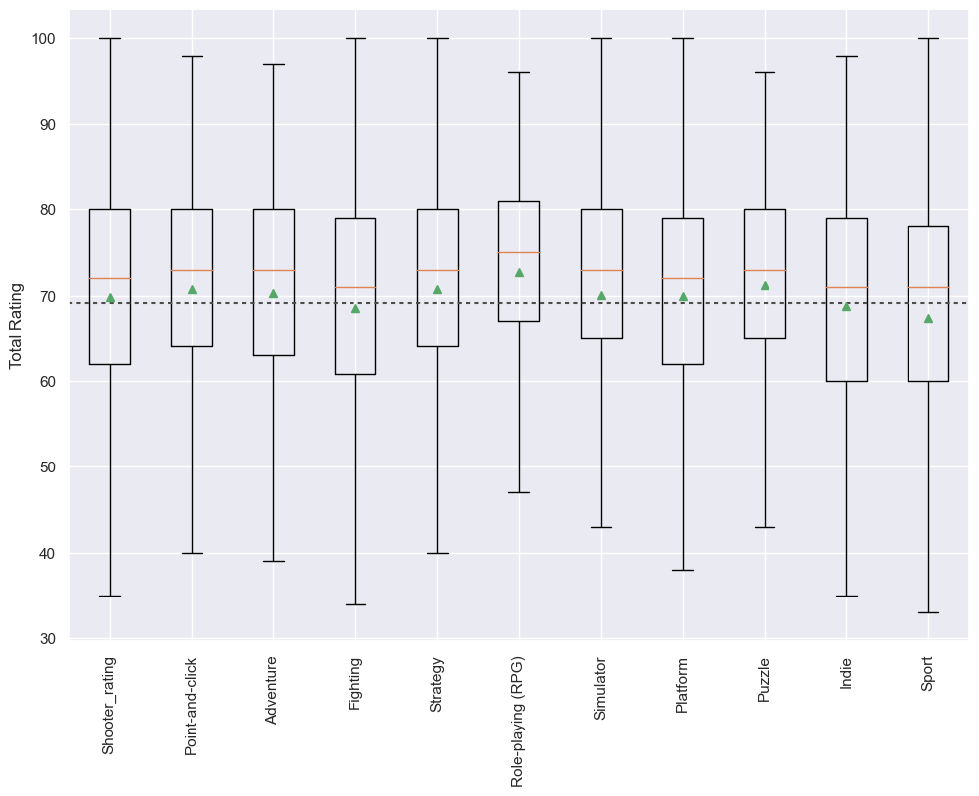
Genre & rating
Most common genres:
Shooting
Highest number of games in dataset (1922)
800 games rated 76 +
Point-and-click
Adventure
Mean same or lower than average rating:
Fighting *same
Indie *same
Sport *lower
Highest total rating range:
RPG
Puzzle
Simulator.
Notes:
Highest total rating range: RPG, Puzzle, and Simulator: This seems right as they are not only the most common played games but many can be played by a large age range.

Slide 9
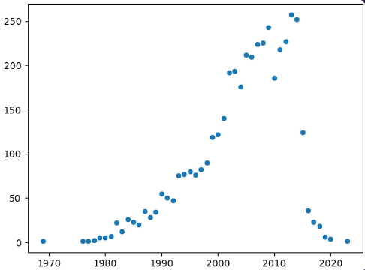
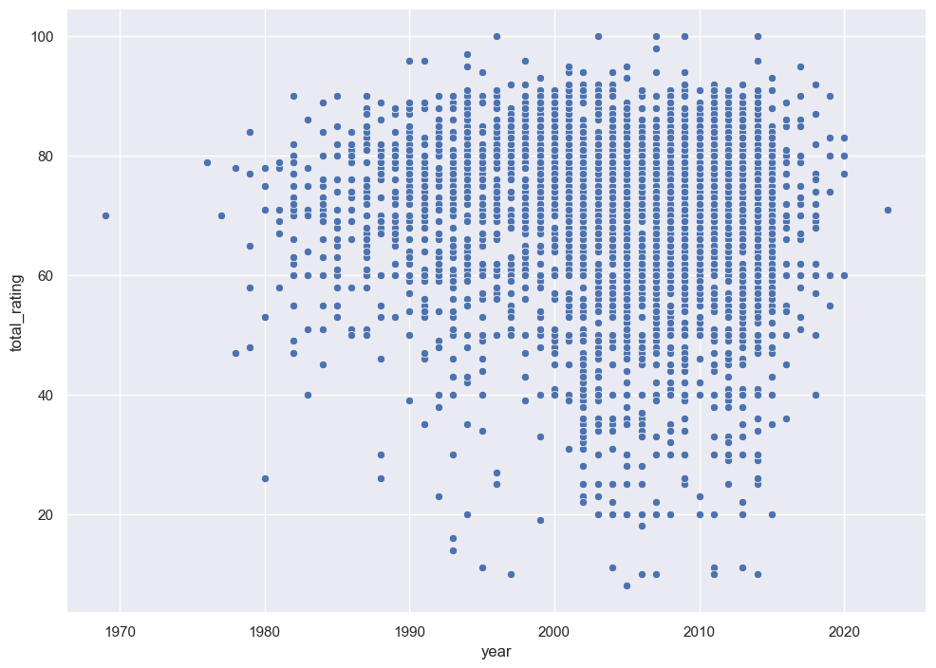
release year
No game being released in the next couple years.
Year with the most releases: 2013 (257 games)
Oldest game released: 09/30/1969
Lunar Lander (text-based game)
Rating 70.

Slide 10
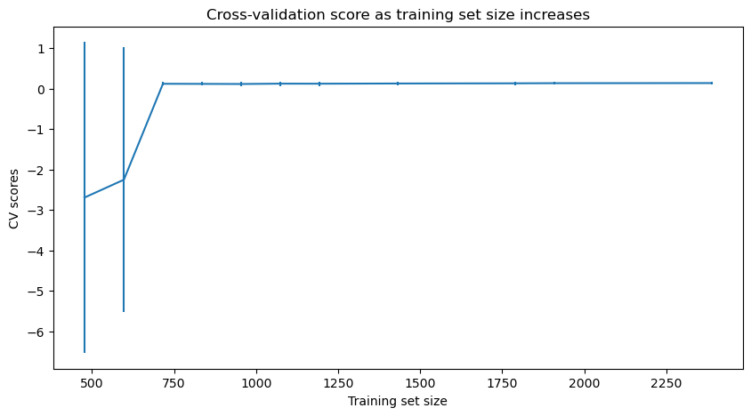
training - testing
Split:
70 Train (2985 – 12 columns)
30 Test (1280 – 12 columns)
Minimum best training set size: 750
2 Models:
Linear Regression
Random Forest Regressor
Used
Simple imputer strategy:
Linear regression: median
Random Forest: mean
Standard Scaler on both models.
Notes:
The above suggests a good value for K is 10. There was an initial rapid increase with k followed by a slight decline. Visually, the variance of the results does not seem to significantly increase as K increases.

Slide 11
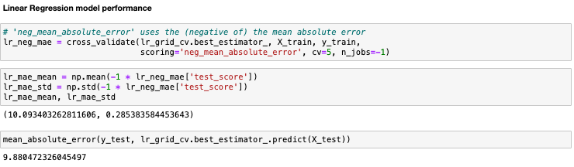
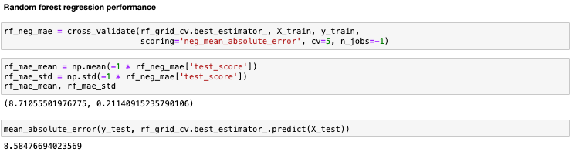
Model selection
Linear Regression
MAE: 9.88 rating error
0.29 variability
Random Forest Regression
MAE: 8.58 rating error
0.21 variability

Slide 12
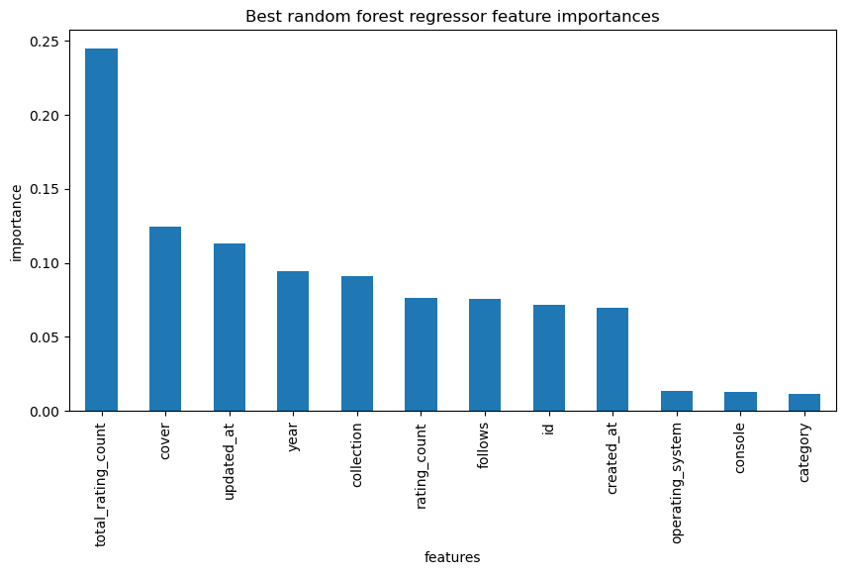
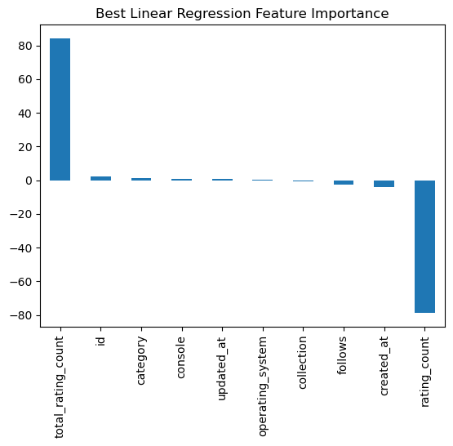
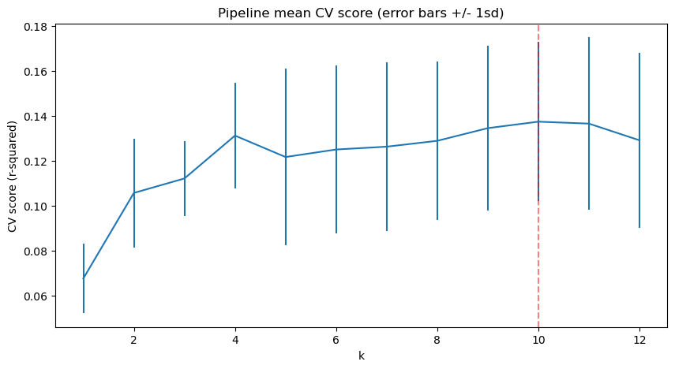
Model TOP features
Random Forest Regressor
Feature importance for model:
Total_rating_count
Cover
Updated_at
Year
Collection
Linear Regressor
Feature importance for model:
Total_rating_count
Id
Category
Console
Updated at
Best parameters:
K = 10
Correlation matrix and top 5 important features for models:
- Total_rating_count and updated_at agrees as top positively correlated feature.
- Category and Console are also slightly positively correlated.
- Cover, year, collection, and id are negatively correlated.

Slide 13
Conclusion
Our model has an error of around 8.6 rating points using our random forest model.
Limitations:
- Popularity (rating < - > rating count)
- Short time frame for project
- Games provided by initial post request.
- Null values in multiple columns in initial data frame dropped and NaN filled with mean values for training set.
- Lack of platform diversity in requested set.
Ideally more data/more post requests could potentially be run through the process to find multiple games that have fewer null values.
Possibly removing total_rating_count as a variable to remove the popularity aspect and allow other features to determine a game’s rating.

